Slide 1
My Favorite Star —— Ed Sheeran
jerry xie 1012

Slide 2
Basic information
Birth name: Edward Christopher Sheeran
Born: 17 February 1991
Age: 26
Birth place: Halifax, West Yorkshire, England

Slide 3


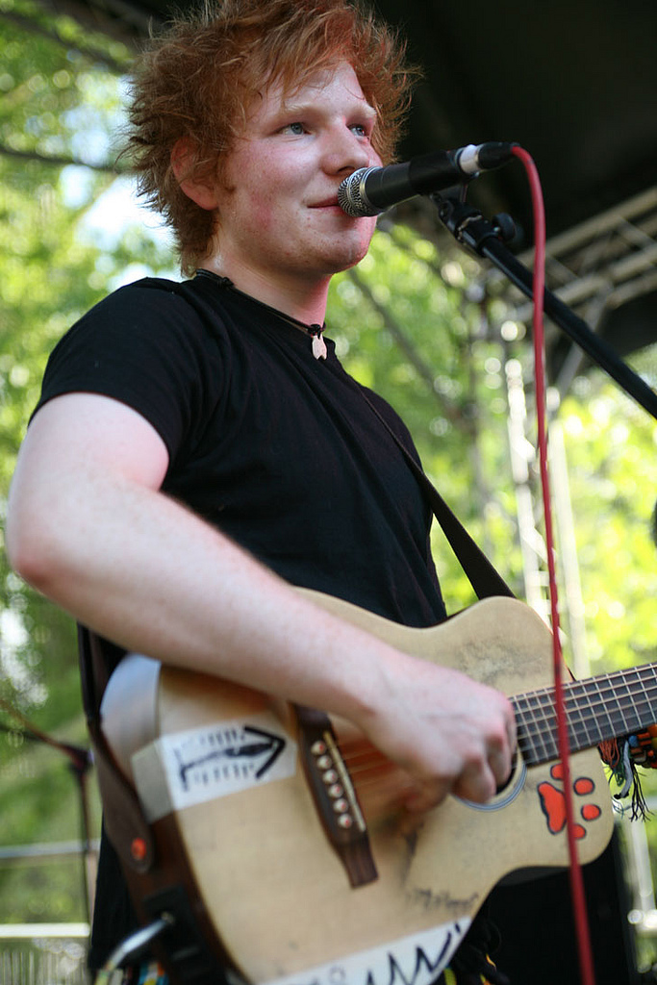
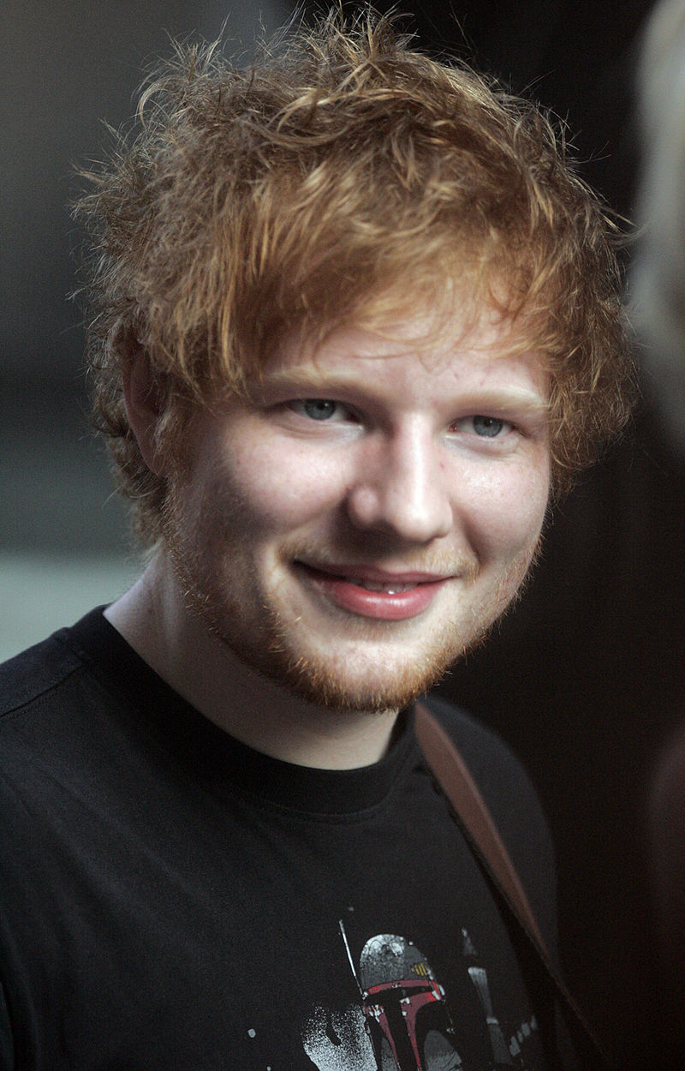



Pictures

Slide 4

Awards
1. Brit Awards for Best British Male Solo Artist and British Breakthrough Act
2. Ivor Novello Award for Best Song Musically and Lyrically
3. two Grammy Awards at the 2016 ceremony : Song of the Year and Best Pop Solo Performance
……

Slide 5
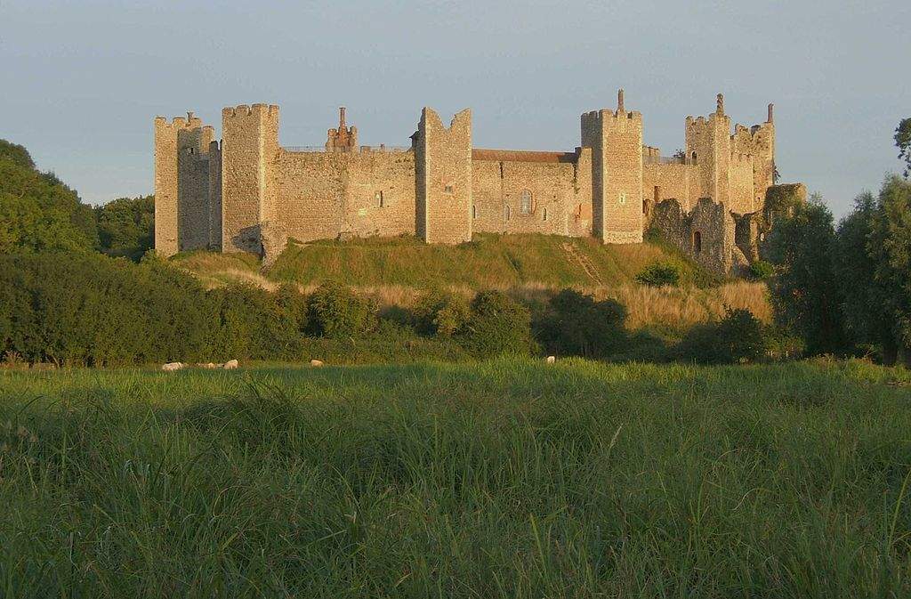
Hometown
Halifax,
West Yorkshire,
England

Slide 6
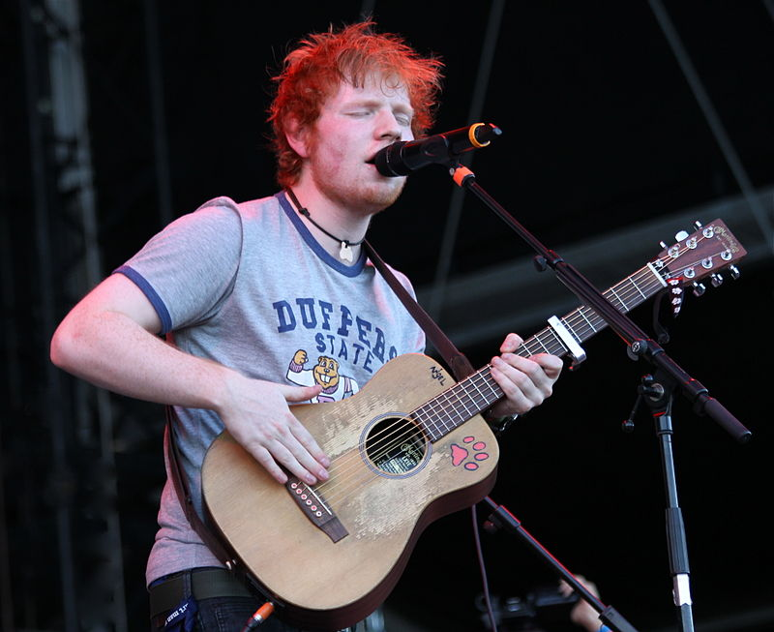
Why I like him
1. Song!!!
2. Appearance
3. Charity: Raised more than £40,000

Slide 7
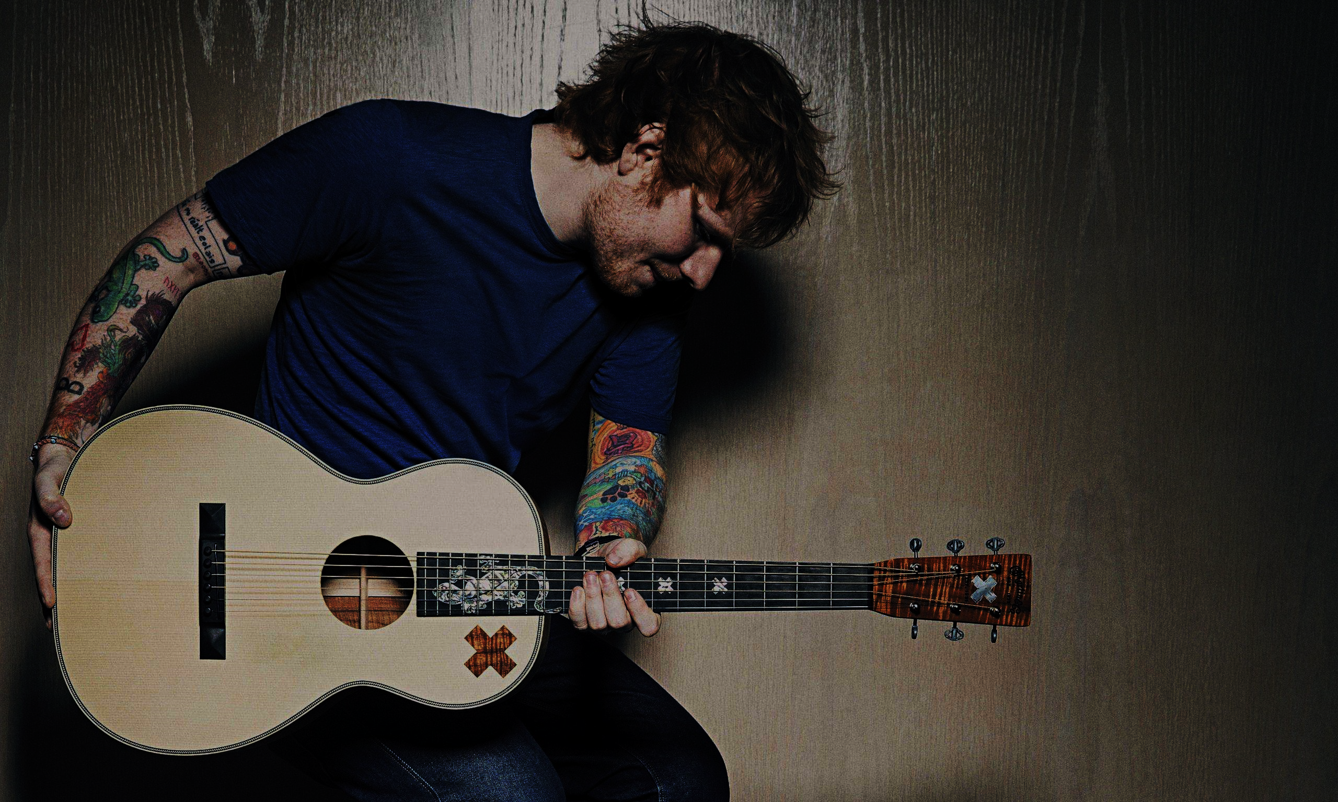
Thanks for listening!
Jerry Xie 1012

